Slide 1
Chapter 3
Arithmetic for Computers
Notes:
Morgan Kaufmann Publishers
*
Chapter 3 — Arithmetic for Computers
‹#›

Slide 2
Arithmetic for Computers
§3.1 Introduction
Operations on integers
Addition and subtraction
Multiplication and division
Dealing with overflow
Floating-point real numbers
Representation and operations
Chapter 3 — Arithmetic for Computers — ‹#›
Notes:
Morgan Kaufmann Publishers
*
Chapter 3 — Arithmetic for Computers
‹#›

Slide 3
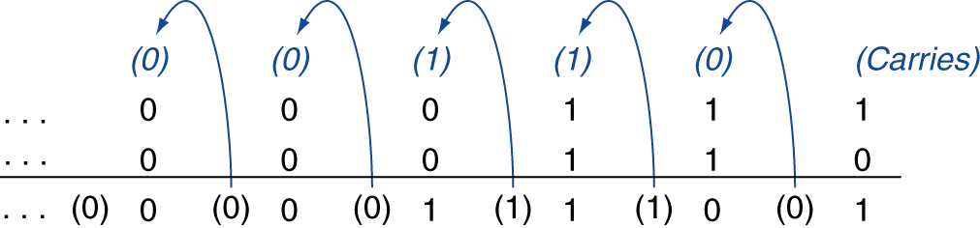
Integer Addition
Example: 7 + 6
§3.2 Addition and Subtraction
Overflow if result out of range
Adding +ve and –ve operands, no overflow
Adding two +ve operands
Overflow if result sign is 1
Adding two –ve operands
Overflow if result sign is 0
Chapter 3 — Arithmetic for Computers — ‹#›
Notes:
Morgan Kaufmann Publishers
*
Chapter 3 — Arithmetic for Computers
‹#›

Slide 4
Integer Subtraction
Add negation of second operand
Example: 7 – 6 = 7 + (–6)
+7: 0000 0000 … 0000 0111 –6: 1111 1111 … 1111 1010 +1: 0000 0000 … 0000 0001
Overflow if result out of range
Subtracting two +ve or two –ve operands, no overflow
Subtracting +ve from –ve operand
Overflow if result sign is 0
Subtracting –ve from +ve operand
Overflow if result sign is 1
Chapter 3 — Arithmetic for Computers — ‹#›
Notes:
Morgan Kaufmann Publishers
*
Chapter 3 — Arithmetic for Computers
‹#›

Slide 5
Arithmetic for Multimedia
Graphics and media processing operates on vectors of 8-bit and 16-bit data
Use 64-bit adder, with partitioned carry chain
Operate on 8×8-bit, 4×16-bit, or 2×32-bit vectors
SIMD (single-instruction, multiple-data)
Saturating operations
On overflow, result is largest representable value
c.f. 2s-complement modulo arithmetic
E.g., clipping in audio, saturation in video
Chapter 3 — Arithmetic for Computers — ‹#›
Notes:
Morgan Kaufmann Publishers
*
Chapter 3 — Arithmetic for Computers
‹#›

Slide 6
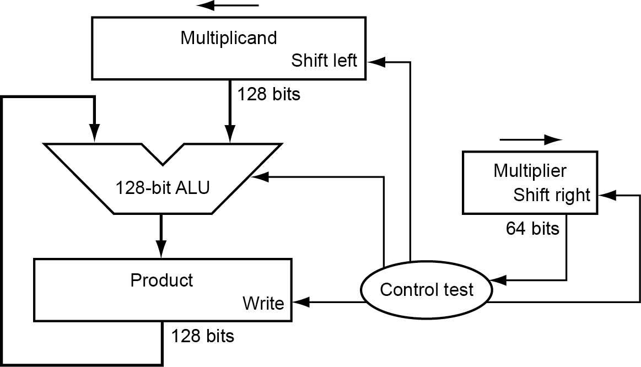
Multiplication
§3.3 Multiplication
Start with long-multiplication approach
multiplicand
1000
× 1001
1000
0000
0000
1000
1001000
multiplier
product
Length of product is the sum of operand lengths
Chapter 3 — Arithmetic for Computers — ‹#›
Notes:
Morgan Kaufmann Publishers
*
Chapter 3 — Arithmetic for Computers
‹#›

Slide 7
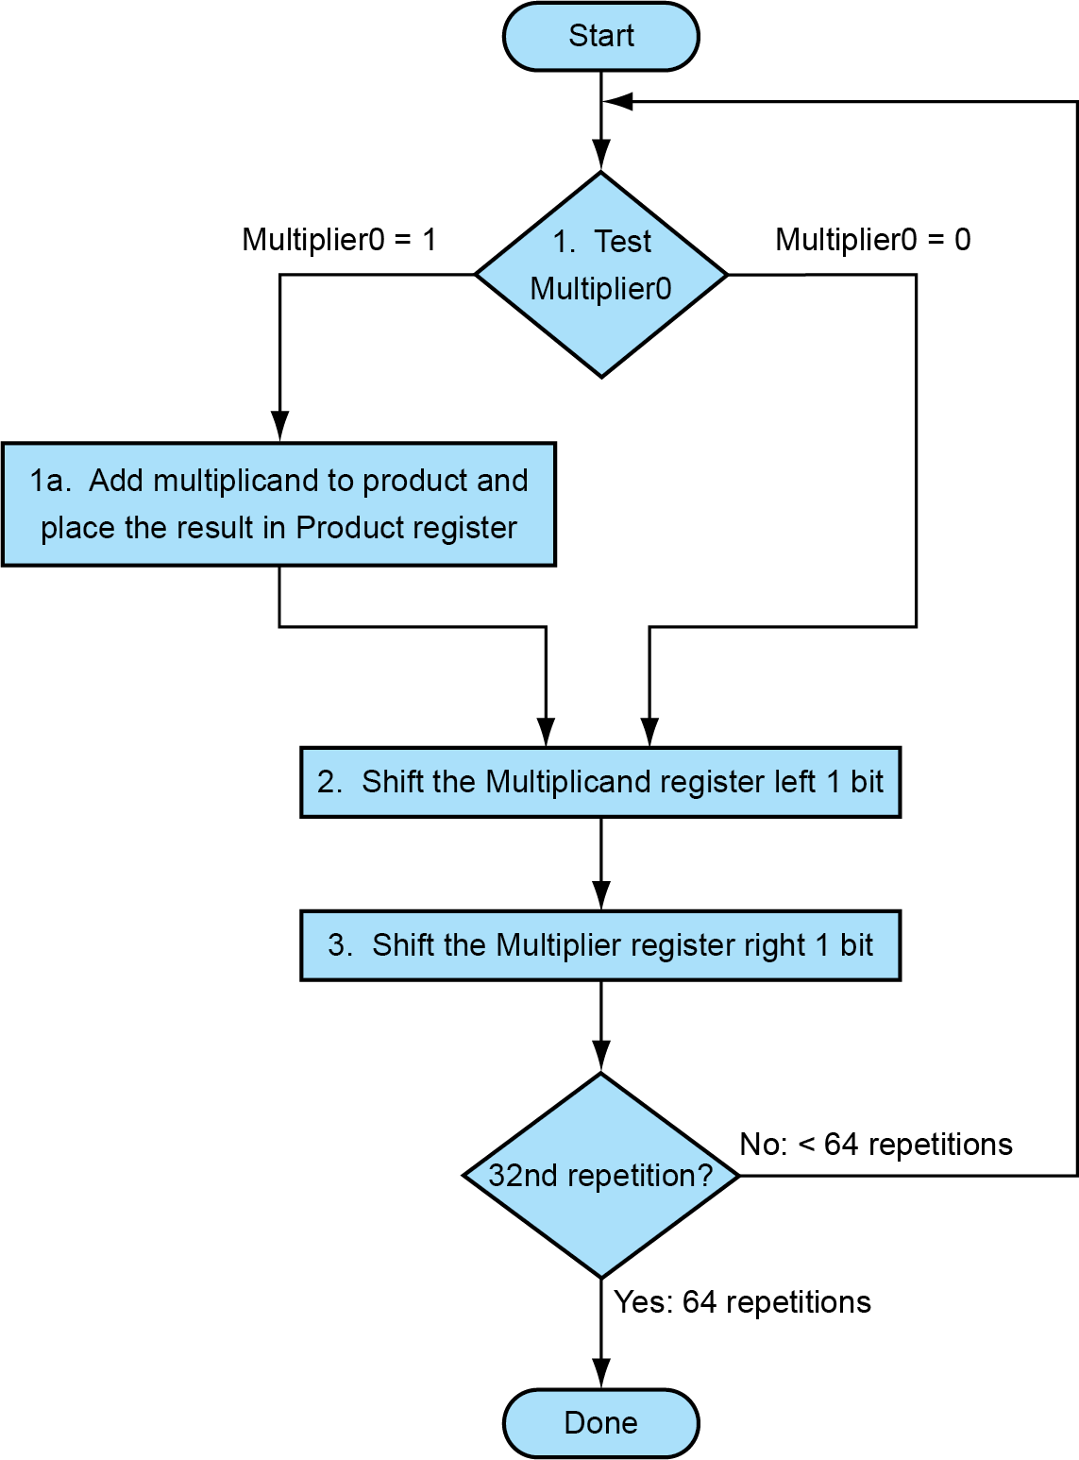
Multiplication Hardware
Initially 0
Chapter 3 — Arithmetic for Computers — ‹#›
Notes:
Morgan Kaufmann Publishers
*
Chapter 3 — Arithmetic for Computers
‹#›

Slide 8
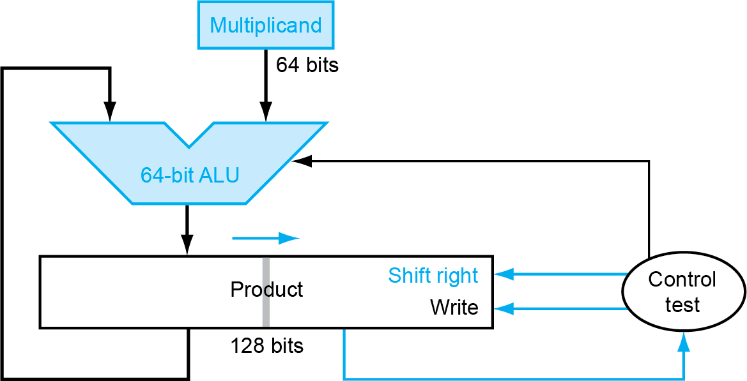
Optimized Multiplier
Perform steps in parallel: add/shift
One cycle per partial-product addition
That’s ok, if frequency of multiplications is low
Chapter 3 — Arithmetic for Computers — ‹#›
Notes:
Morgan Kaufmann Publishers
*
Chapter 3 — Arithmetic for Computers
‹#›

Slide 9
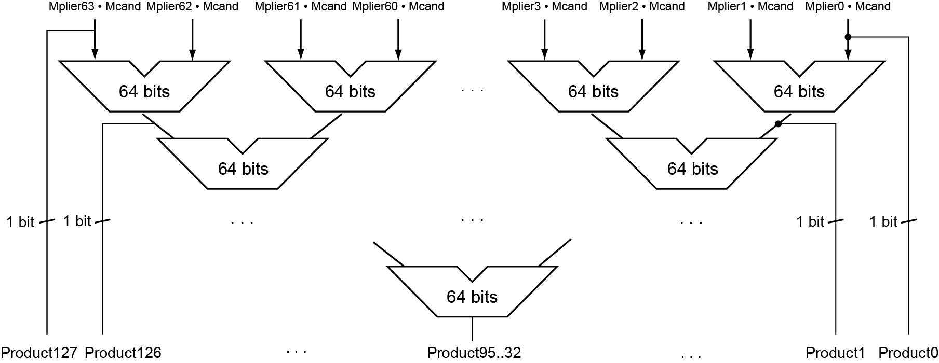
Faster Multiplier
Uses multiple adders
Cost/performance tradeoff
Can be pipelined
Several multiplication performed in parallel
Chapter 3 — Arithmetic for Computers — ‹#›
Notes:
Morgan Kaufmann Publishers
*
Chapter 3 — Arithmetic for Computers
‹#›

Slide 10
RISC-V Multiplication
Four multiply instructions:
mul: multiply
Gives the lower 64 bits of the product
mulh: multiply high
Gives the upper 64 bits of the product, assuming the operands are signed
mulhu: multiply high unsigned
Gives the upper 64 bits of the product, assuming the operands are unsigned
mulhsu: multiply high signed/unsigned
Gives the upper 64 bits of the product, assuming one operand is signed and the other unsigned
Use mulh result to check for 64-bit overflow
Chapter 3 — Arithmetic for Computers — ‹#›
Notes:
Morgan Kaufmann Publishers
*
Chapter 3 — Arithmetic for Computers
‹#›

Slide 11
Division
§3.4 Division
Check for 0 divisor
Long division approach
If divisor ≤ dividend bits
1 bit in quotient, subtract
Otherwise
0 bit in quotient, bring down next dividend bit
Restoring division
Do the subtract, and if remainder goes < 0, add divisor back
Signed division
Divide using absolute values
Adjust sign of quotient and remainder as required
quotient
dividend
1001
1000 1001010
-1000
10
101
1010
-1000
10
divisor
remainder
n-bit operands yield n-bit quotient and remainder
Chapter 3 — Arithmetic for Computers — ‹#›
Notes:
Morgan Kaufmann Publishers
*
Chapter 3 — Arithmetic for Computers
‹#›

Slide 12
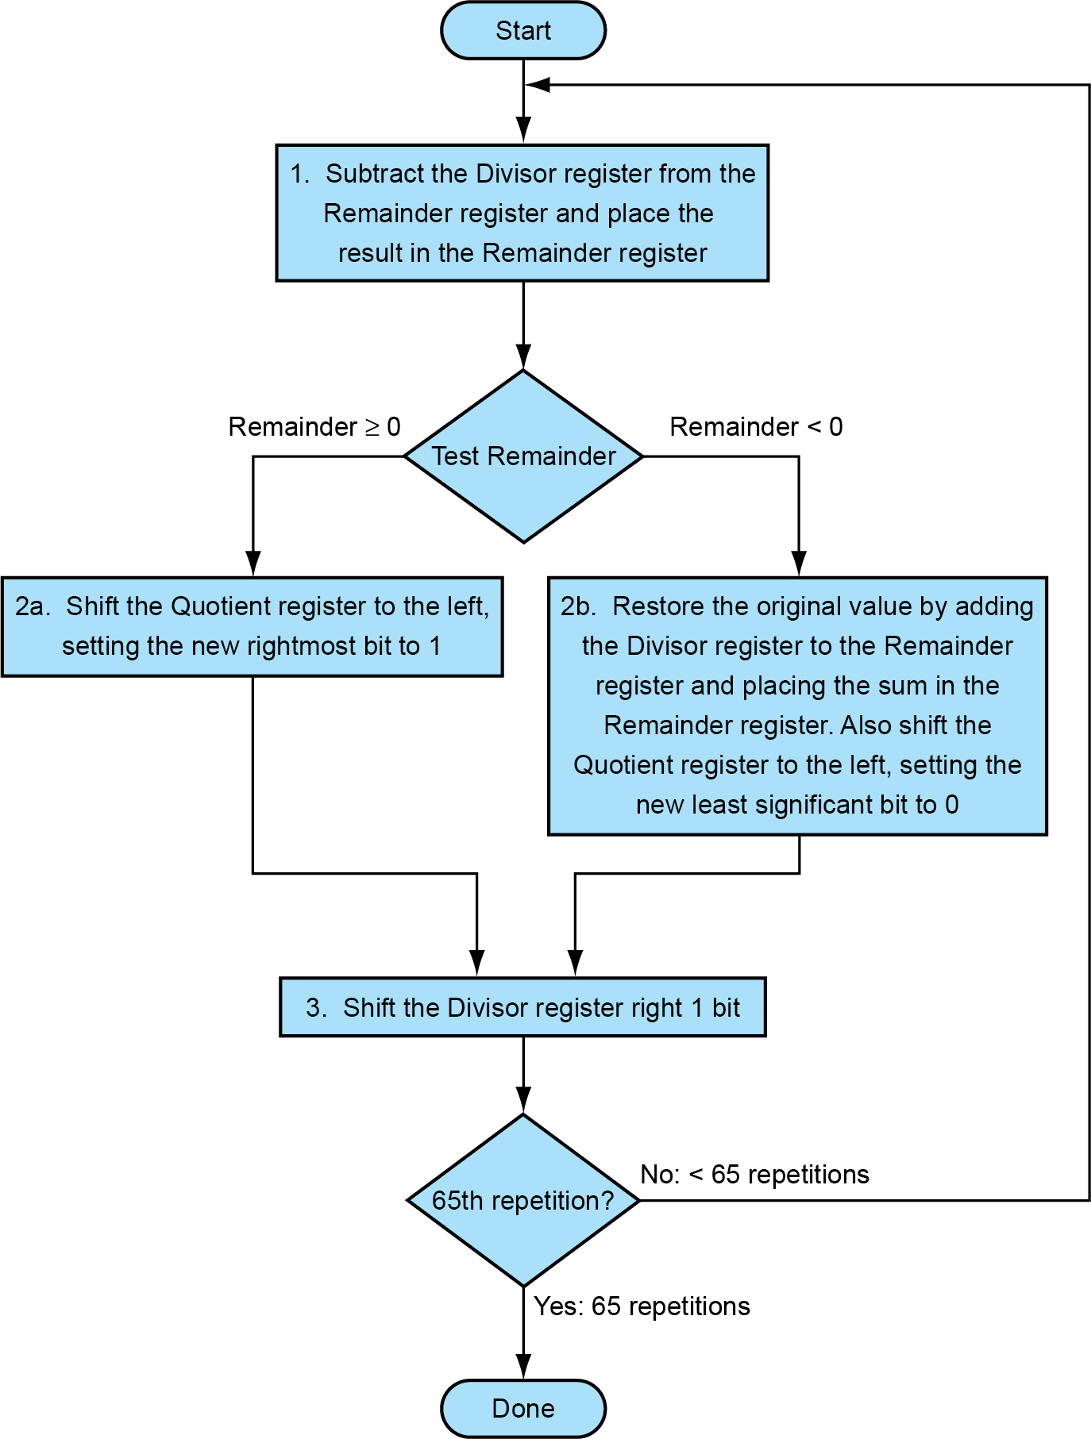
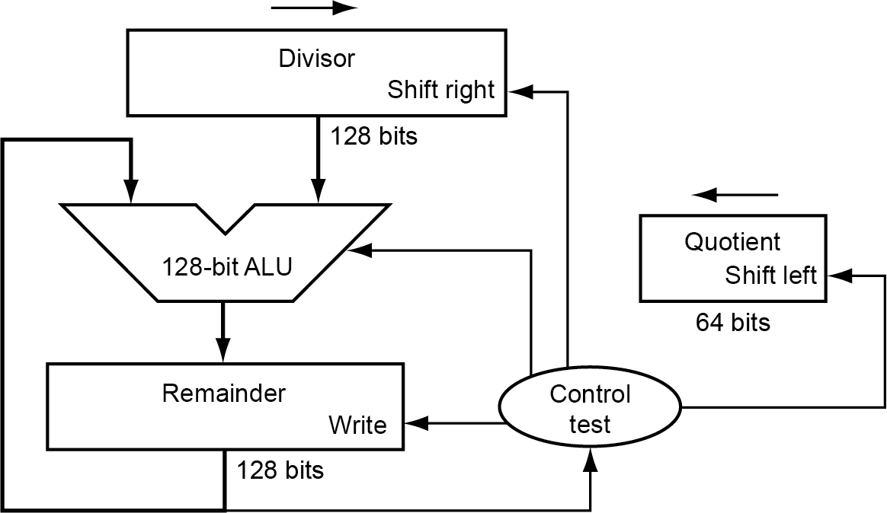
Division Hardware
Initially divisor in left half
Initially dividend
Chapter 3 — Arithmetic for Computers — ‹#›
Notes:
Morgan Kaufmann Publishers
*
Chapter 3 — Arithmetic for Computers
‹#›

Slide 13
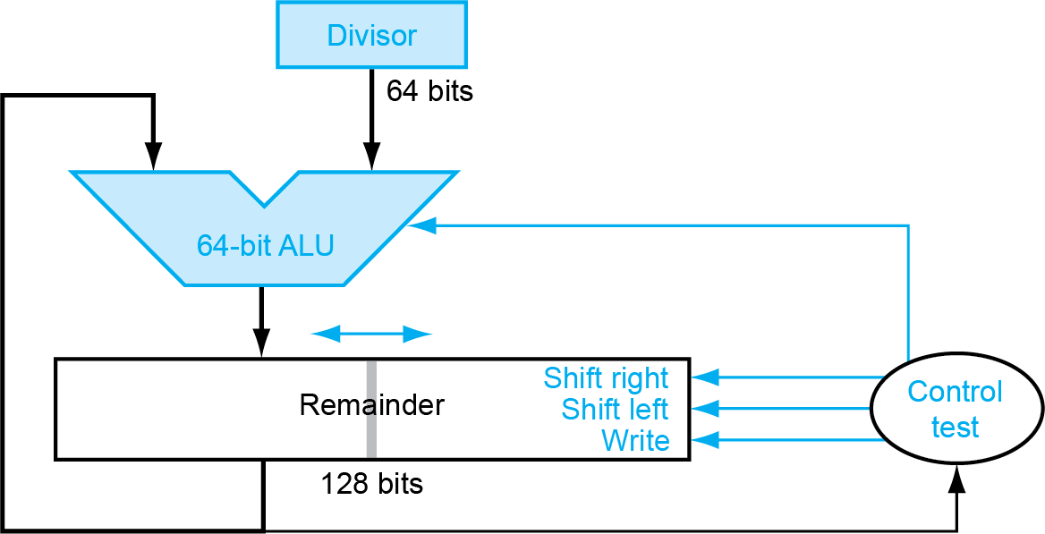
Optimized Divider
One cycle per partial-remainder subtraction
Looks a lot like a multiplier!
Same hardware can be used for both
Chapter 3 — Arithmetic for Computers — ‹#›
Notes:
Morgan Kaufmann Publishers
*
Chapter 3 — Arithmetic for Computers
‹#›

Slide 14
Faster Division
Can’t use parallel hardware as in multiplier
Subtraction is conditional on sign of remainder
Faster dividers (e.g. SRT devision) generate multiple quotient bits per step
Still require multiple steps
Chapter 3 — Arithmetic for Computers — ‹#›
Notes:
Morgan Kaufmann Publishers
*
Chapter 3 — Arithmetic for Computers
‹#›

Slide 15
RISC-V Division
Four instructions:
div, rem: signed divide, remainder
divu, remu: unsigned divide, remainder
Overflow and division-by-zero don’t produce errors
Just return defined results
Faster for the common case of no error
Chapter 3 — Arithmetic for Computers — ‹#›
Notes:
Morgan Kaufmann Publishers
*
Chapter 3 — Arithmetic for Computers
‹#›

Slide 16
Floating Point
§3.5 Floating Point
Representation for non-integral numbers
Including very small and very large numbers
Like scientific notation
–2.34 × 10⁵⁶
+0.002 × 10^{–4}
+987.02 × 10⁹
In binary
±1.xxxxxxx₂ × 2^{yyyy}
Types float and double in C
normalized
not normalized
Chapter 3 — Arithmetic for Computers — ‹#›
Notes:
Morgan Kaufmann Publishers
*
Chapter 3 — Arithmetic for Computers
‹#›

Slide 17
Floating Point Standard
Defined by IEEE Std 754-1985
Developed in response to divergence of representations
Portability issues for scientific code
Now almost universally adopted
Two representations
Single precision (32-bit)
Double precision (64-bit)
Chapter 3 — Arithmetic for Computers — ‹#›
Notes:
Morgan Kaufmann Publishers
*
Chapter 3 — Arithmetic for Computers
‹#›

Slide 18
IEEE Floating-Point Format
single: 8 bits double: 11 bits
single: 23 bits double: 52 bits
S
Exponent
Fraction
S: sign bit (0 ⇒ non-negative, 1 ⇒ negative)
Normalize significand: 1.0 ≤ |significand| < 2.0
Always has a leading pre-binary-point 1 bit, so no need to represent it explicitly (hidden bit)
Significand is Fraction with the “1.” restored
Exponent: excess representation: actual exponent + Bias
Ensures exponent is unsigned
Single: Bias = 127; Double: Bias = 1203
Chapter 3 — Arithmetic for Computers — ‹#›
Notes:
Morgan Kaufmann Publishers
*
Chapter 3 — Arithmetic for Computers
‹#›

Slide 19
Single-Precision Range
Exponents 00000000 and 11111111 reserved
Smallest value
Exponent: 00000001 ⇒ actual exponent = 1 – 127 = –126
Fraction: 000…00 ⇒ significand = 1.0
±1.0 × 2^{–126} ≈ ±1.2 × 10^{–38}
Largest value
exponent: 11111110 ⇒ actual exponent = 254 – 127 = +127
Fraction: 111…11 ⇒ significand ≈ 2.0
±2.0 × 2⁺¹²⁷ ≈ ±3.4 × 10⁺³⁸
Chapter 3 — Arithmetic for Computers — ‹#›
Notes:
Morgan Kaufmann Publishers
*
Chapter 3 — Arithmetic for Computers
‹#›

Slide 20
Double-Precision Range
Exponents 0000…00 and 1111…11 reserved
Smallest value
Exponent: 00000000001 ⇒ actual exponent = 1 – 1023 = –1022
Fraction: 000…00 ⇒ significand = 1.0
±1.0 × 2^{–1022} ≈ ±2.2 × 10^{–308}
Largest value
Exponent: 11111111110 ⇒ actual exponent = 2046 – 1023 = +1023
Fraction: 111…11 ⇒ significand ≈ 2.0
±2.0 × 2⁺¹⁰²³ ≈ ±1.8 × 10⁺³⁰⁸
Chapter 3 — Arithmetic for Computers — ‹#›
Notes:
Morgan Kaufmann Publishers
*
Chapter 3 — Arithmetic for Computers
‹#›

Slide 21
Floating-Point Precision
Relative precision
all fraction bits are significant
Single: approx 2^{–23}
Equivalent to 23 × log₁₀2 ≈ 23 × 0.3 ≈ 6 decimal digits of precision
Double: approx 2^{–52}
Equivalent to 52 × log₁₀2 ≈ 52 × 0.3 ≈ 16 decimal digits of precision
Chapter 3 — Arithmetic for Computers — ‹#›
Notes:
Morgan Kaufmann Publishers
*
Chapter 3 — Arithmetic for Computers
‹#›

Slide 22
Floating-Point Example
Represent –0.75
–0.75 = (–1)¹ × 1.1₂ × 2^{–1}
S = 1
Fraction = 1000…00₂
Exponent = –1 + Bias
Single: –1 + 127 = 126 = 01111110₂
Double: –1 + 1023 = 1022 = 01111111110₂
Single: 1011111101000…00
Double: 1011111111101000…00
Chapter 3 — Arithmetic for Computers — ‹#›
Notes:
Morgan Kaufmann Publishers
*
Chapter 3 — Arithmetic for Computers
‹#›

Slide 23
Floating-Point Example
What number is represented by the single-precision float
11000000101000…00
S = 1
Fraction = 01000…00₂
Fxponent = 10000001₂ = 129
x = (–1)¹ × (1 + 01₂) × 2^{(129 – 127)}
= (–1) × 1.25 × 2²
= –5.0
Chapter 3 — Arithmetic for Computers — ‹#›
Notes:
Morgan Kaufmann Publishers
*
Chapter 3 — Arithmetic for Computers
‹#›

Slide 24
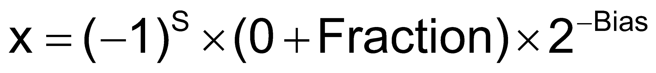
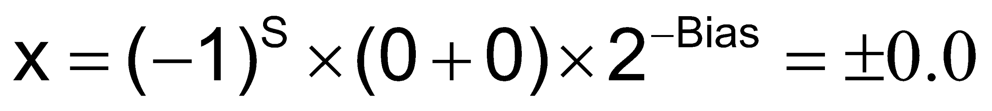
Denormal Numbers
Exponent = 000...0 ⇒ hidden bit is 0
Smaller than normal numbers
allow for gradual underflow, with diminishing precision
Denormal with fraction = 000...0
Two representations of 0.0!
Chapter 3 — Arithmetic for Computers — ‹#›
Notes:
Morgan Kaufmann Publishers
*
Chapter 3 — Arithmetic for Computers
‹#›

Slide 25
Infinities and NaNs
Exponent = 111...1, Fraction = 000...0
±Infinity
Can be used in subsequent calculations, avoiding need for overflow check
Exponent = 111...1, Fraction ≠ 000...0
Not-a-Number (NaN)
Indicates illegal or undefined result
e.g., 0.0 / 0.0
Can be used in subsequent calculations
Chapter 3 — Arithmetic for Computers — ‹#›
Notes:
Morgan Kaufmann Publishers
*
Chapter 3 — Arithmetic for Computers
‹#›

Slide 26
Floating-Point Addition
Consider a 4-digit decimal example
9.999 × 10¹ + 1.610 × 10^{–1}
1. Align decimal points
Shift number with smaller exponent
9.999 × 10¹ + 0.016 × 10¹
2. Add significands
9.999 × 10¹ + 0.016 × 10¹ = 10.015 × 10¹
3. Normalize result & check for over/underflow
1.0015 × 10²
4. Round and renormalize if necessary
1.002 × 10²
Chapter 3 — Arithmetic for Computers — ‹#›
Notes:
Morgan Kaufmann Publishers
*
Chapter 3 — Arithmetic for Computers
‹#›

Slide 27
Floating-Point Addition
Now consider a 4-digit binary example
1.000₂ × 2^{–1} + –1.110₂ × 2^{–2} (0.5 + –0.4375)
1. Align binary points
Shift number with smaller exponent
1.000₂ × 2^{–1} + –0.111₂ × 2^{–1}
2. Add significands
1.000₂ × 2^{–1} + –0.111₂ × 2–1 = 0.001₂ × 2^{–1}
3. Normalize result & check for over/underflow
1.000₂ × 2^{–4}, with no over/underflow
4. Round and renormalize if necessary
1.000₂ × 2^{–4} (no change) = 0.0625
Chapter 3 — Arithmetic for Computers — ‹#›
Notes:
Morgan Kaufmann Publishers
*
Chapter 3 — Arithmetic for Computers
‹#›

Slide 28
FP Adder Hardware
Much more complex than integer adder
Doing it in one clock cycle would take too long
Much longer than integer operations
Slower clock would penalize all instructions
FP adder usually takes several cycles
Can be pipelined
Chapter 3 — Arithmetic for Computers — ‹#›
Notes:
Morgan Kaufmann Publishers
*
Chapter 3 — Arithmetic for Computers
‹#›

Slide 29
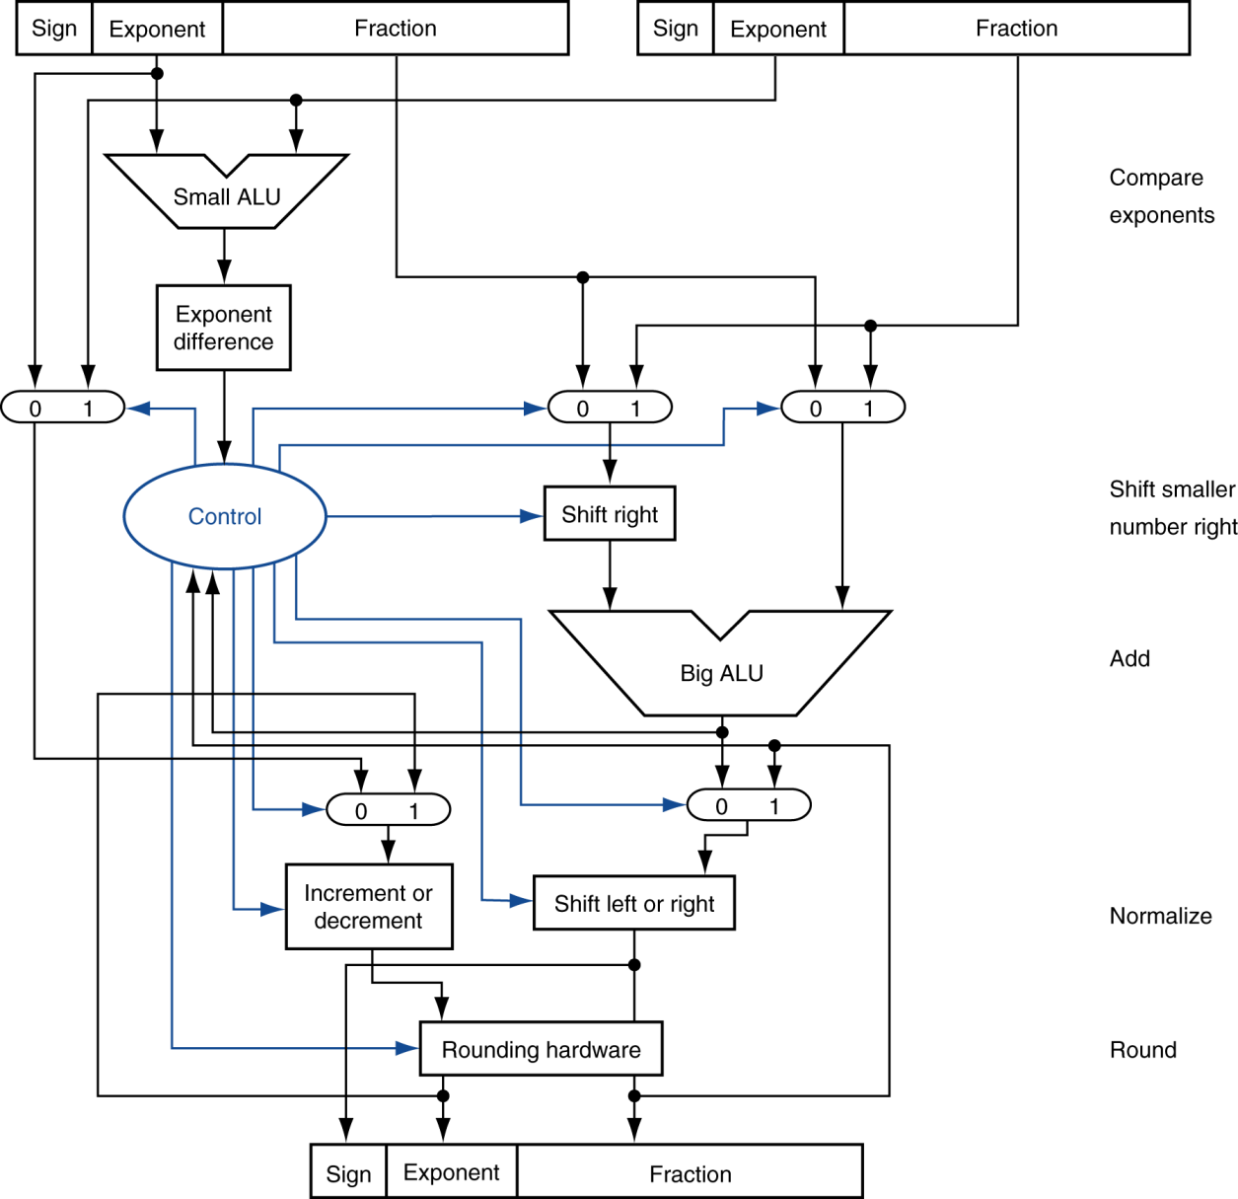
FP Adder Hardware
Step 1
Step 2
Step 3
Step 4
Chapter 3 — Arithmetic for Computers — ‹#›
Notes:
Morgan Kaufmann Publishers
*
Chapter 3 — Arithmetic for Computers
‹#›

Slide 30
Floating-Point Multiplication
Consider a 4-digit decimal example
1.110 × 10¹⁰ × 9.200 × 10^{–5}
1. Add exponents
For biased exponents, subtract bias from sum
New exponent = 10 + –5 = 5
2. Multiply significands
1.110 × 9.200 = 10.212 ⇒ 10.212 × 10⁵
3. Normalize result & check for over/underflow
1.0212 × 10⁶
4. Round and renormalize if necessary
1.021 × 10⁶
5. Determine sign of result from signs of operands
+1.021 × 10⁶
Chapter 3 — Arithmetic for Computers — ‹#›
Notes:
Morgan Kaufmann Publishers
*
Chapter 3 — Arithmetic for Computers
‹#›

Slide 31
Floating-Point Multiplication
Now consider a 4-digit binary example
1.000₂ × 2^{–1} × –1.110₂ × 2^{–2} (0.5 × –0.4375)
1. Add exponents
Unbiased: –1 + –2 = –3
Biased: (–1 + 127) + (–2 + 127) = –3 + 254 – 127 = –3 + 127
2. Multiply significands
1.000₂ × 1.110₂ = 1.1102 ⇒ 1.110₂ × 2^{–3}
3. Normalize result & check for over/underflow
1.110₂ × 2^{–3} (no change) with no over/underflow
4. Round and renormalize if necessary
1.110₂ × 2^{–3} (no change)
5. Determine sign: +ve × –ve ⇒ –ve
–1.110₂ × 2^{–3} = –0.21875
Chapter 3 — Arithmetic for Computers — ‹#›
Notes:
Morgan Kaufmann Publishers
*
Chapter 3 — Arithmetic for Computers
‹#›

Slide 32
FP Arithmetic Hardware
FP multiplier is of similar complexity to FP adder
But uses a multiplier for significands instead of an adder
FP arithmetic hardware usually does
Addition, subtraction, multiplication, division, reciprocal, square-root
FP ↔ integer conversion
Operations usually takes several cycles
Can be pipelined
Chapter 3 — Arithmetic for Computers — ‹#›
Notes:
Morgan Kaufmann Publishers
*
Chapter 3 — Arithmetic for Computers
‹#›

Slide 33
FP Instructions in RISC-V
Separate FP registers: f0, …, f31
double-precision
single-precision values stored in the lower 32 bits
FP instructions operate only on FP registers
Programs generally don’t do integer ops on FP data, or vice versa
More registers with minimal code-size impact
FP load and store instructions
flw, fld
fsw, fsd
Chapter 3 — Arithmetic for Computers — ‹#›
Notes:
Morgan Kaufmann Publishers
*
Chapter 3 — Arithmetic for Computers
‹#›

Slide 34
FP Instructions in RISC-V
Single-precision arithmetic
fadd.s, fsub.s, fmul.s, fdiv.s, fsqrt.s
e.g., fadds.s f2, f4, f6
Double-precision arithmetic
fadd.d, fsub.d, fmul.d, fdiv.d, fsqrt.d
e.g., fadd.d f2, f4, f6
Single- and double-precision comparison
feq.s, flt.s, fle.s
feq.d, flt.d, fle.d
Result is 0 or 1 in integer destination register
Use beq, bne to branch on comparison result
Branch on FP condition code true or false
B.cond
Chapter 3 — Arithmetic for Computers — ‹#›
Notes:
Morgan Kaufmann Publishers
*
Chapter 3 — Arithmetic for Computers
‹#›

Slide 35
FP Example: °F to °C
C code:
float f2c (float fahr) { return ((5.0/9.0)*(fahr - 32.0)); }
fahr in f10, result in f10, literals in global memory space
Compiled RISC-V code:
f2c:
flw f0,const5(x3) // f0 = 5.0f
flw f1,const9(x3) // f1 = 9.0f
fdiv.s f0, f0, f1 // f0 = 5.0f / 9.0f
flw f1,const32(x3) // f1 = 32.0f
fsub.s f10,f10,f1 // f10 = fahr – 32.0
fmul.s f10,f0,f10 // f10 = (5.0f/9.0f) * (fahr–32.0f)
jalr x0,0(x1) // return
Chapter 3 — Arithmetic for Computers — ‹#›
Notes:
Morgan Kaufmann Publishers
*
Chapter 3 — Arithmetic for Computers
‹#›

Slide 36
FP Example: Array Multiplication
C = C + A × B
All 32 × 32 matrices, 64-bit double-precision elements
C code:
void mm (double c[][], double a[][], double b[][]) { size_t i, j, k; for (i = 0; i < 32; i = i + 1) for (j = 0; j < 32; j = j + 1) for (k = 0; k < 32; k = k + 1) c[i][j] = c[i][j] + a[i][k] * b[k][j]; }
Addresses of c, a, b in x10, x11, x12, and i, j, k in x5, x6, x7
Chapter 3 — Arithmetic for Computers — ‹#›
Notes:
Morgan Kaufmann Publishers
*
Chapter 3 — Arithmetic for Computers
‹#›

Slide 37
FP Example: Array Multiplication
RISC-V code:
mm:...
li x28,32 // x28 = 32 (row size/loop end)
li x5,0 // i = 0; initialize 1st for loop
L1: li x6,0 // j = 0; initialize 2nd for loop
L2: li x7,0 // k = 0; initialize 3rd for loop
slli x30,x5,5 // x30 = i * 2**5 (size of row of c)
add x30,x30,x6 // x30 = i * size(row) + j
slli x30,x30,3 // x30 = byte offset of [i][j]
add x30,x10,x30 // x30 = byte address of c[i][j]
fld f0,0(x30) // f0 = c[i][j]
L3: slli x29,x7,5 // x29 = k * 2**5 (size of row of b)
add x29,x29,x6 // x29 = k * size(row) + j
slli x29,x29,3 // x29 = byte offset of [k][j]
add x29,x12,x29 // x29 = byte address of b[k][j]
fld f1,0(x29) // f1 = b[k][j]
Chapter 3 — Arithmetic for Computers — ‹#›
Notes:
Morgan Kaufmann Publishers
*
Chapter 3 — Arithmetic for Computers
‹#›

Slide 38
FP Example: Array Multiplication
…
slli x29,x5,5 // x29 = i * 2**5 (size of row of a)
add x29,x29,x7 // x29 = i * size(row) + k
slli x29,x29,3 // x29 = byte offset of [i][k]
add x29,x11,x29 // x29 = byte address of a[i][k]
fld f2,0(x29) // f2 = a[i][k]
fmul.d f1, f2, f1 // f1 = a[i][k] * b[k][j]
fadd.d f0, f0, f1 // f0 = c[i][j] + a[i][k] * b[k][j]
addi x7,x7,1 // k = k + 1
bltu x7,x28,L3 // if (k < 32) go to L3
fsd f0,0(x30) // c[i][j] = f0
addi x6,x6,1 // j = j + 1
bltu x6,x28,L2 // if (j < 32) go to L2
addi x5,x5,1 // i = i + 1
bltu x5,x28,L1 // if (i < 32) go to L1
Chapter 3 — Arithmetic for Computers — ‹#›
Notes:
Morgan Kaufmann Publishers
*
Chapter 3 — Arithmetic for Computers
‹#›

Slide 39
Accurate Arithmetic
IEEE Std 754 specifies additional rounding control
Extra bits of precision (guard, round, sticky)
Choice of rounding modes
Allows programmer to fine-tune numerical behavior of a computation
Not all FP units implement all options
Most programming languages and FP libraries just use defaults
Trade-off between hardware complexity, performance, and market requirements
Chapter 3 — Arithmetic for Computers — ‹#›
Notes:
Morgan Kaufmann Publishers
*
Chapter 3 — Arithmetic for Computers
‹#›

Slide 40
Subword Parallellism
Graphics and audio applications can take advantage of performing simultaneous operations on short vectors
Example: 128-bit adder:
Sixteen 8-bit adds
Eight 16-bit adds
Four 32-bit adds
Also called data-level parallelism, vector parallelism, or Single Instruction, Multiple Data (SIMD)
§3.6 Parallelism and Computer Arithmetic: Subword Parallelism
Chapter 3 — Arithmetic for Computers — ‹#›

Slide 41
x86 FP Architecture
Originally based on 8087 FP coprocessor
8 × 80-bit extended-precision registers
Used as a push-down stack
Registers indexed from TOS: ST(0), ST(1), …
FP values are 32-bit or 64 in memory
Converted on load/store of memory operand
Integer operands can also be converted on load/store
Very difficult to generate and optimize code
Result: poor FP performance
§3.7 Real Stuff: Streaming SIMD Extensions and AVX in x86
Chapter 3 — Arithmetic for Computers — ‹#›
Notes:
Morgan Kaufmann Publishers
*
Chapter 3 — Arithmetic for Computers
‹#›

Slide 42
x86 FP Instructions
Data transfer | Arithmetic | Compare | Transcendental
FILD mem/ST(i) FISTP mem/ST(i) FLDPI FLD1 FLDZ | FIADDP mem/ST(i) FISUBRP mem/ST(i) FIMULP mem/ST(i) FIDIVRP mem/ST(i) FSQRT FABS FRNDINT | FICOMP FIUCOMP FSTSW AX/mem | FPATAN F2XMI FCOS FPTAN FPREM FPSIN FYL2X
Optional variations
I: integer operand
P: pop operand from stack
R: reverse operand order
But not all combinations allowed
Chapter 3 — Arithmetic for Computers — ‹#›
Notes:
Morgan Kaufmann Publishers
*
Chapter 3 — Arithmetic for Computers
‹#›

Slide 43
Streaming SIMD Extension 2 (SSE2)
Adds 4 × 128-bit registers
Extended to 8 registers in AMD64/EM64T
Can be used for multiple FP operands
2 × 64-bit double precision
4 × 32-bit double precision
Instructions operate on them simultaneously
Single-Instruction Multiple-Data
Chapter 3 — Arithmetic for Computers — ‹#›
Notes:
Morgan Kaufmann Publishers
*
Chapter 3 — Arithmetic for Computers
‹#›

Slide 44
Matrix Multiply
Unoptimized code:
1. void dgemm (int n, double* A, double* B, double* C)
2. {
3. for (int i = 0; i < n; ++i)
4. for (int j = 0; j < n; ++j)
5. {
6. double cij = C[i+j*n]; /* cij = C[i][j] */
7. for(int k = 0; k < n; k++ )
8. cij += A[i+k*n] * B[k+j*n]; /* cij += A[i][k]*B[k][j] */
9. C[i+j*n] = cij; /* C[i][j] = cij */
10. }
11. }
§3.8 Going Faster: Subword Parallelism and Matrix Multiply
Chapter 3 — Arithmetic for Computers — ‹#›

Slide 45
Matrix Multiply
x86 assembly code:
1. vmovsd (%r10),%xmm0 # Load 1 element of C into %xmm0
2. mov %rsi,%rcx # register %rcx = %rsi
3. xor %eax,%eax # register %eax = 0
4. vmovsd (%rcx),%xmm1 # Load 1 element of B into %xmm1
5. add %r9,%rcx # register %rcx = %rcx + %r9
6. vmulsd (%r8,%rax,8),%xmm1,%xmm1 # Multiply %xmm1, element of A
7. add $0x1,%rax # register %rax = %rax + 1
8. cmp %eax,%edi # compare %eax to %edi
9. vaddsd %xmm1,%xmm0,%xmm0 # Add %xmm1, %xmm0
10. jg 30 <dgemm+0x30> # jump if %eax > %edi
11. add $0x1,%r11d # register %r11 = %r11 + 1
12. vmovsd %xmm0,(%r10) # Store %xmm0 into C element
Chapter 3 — Arithmetic for Computers — ‹#›

Slide 46
Matrix Multiply
Optimized C code:
1. #include <x86intrin.h>
2. void dgemm (int n, double* A, double* B, double* C)
3. {
4. for ( int i = 0; i < n; i+=4 )
5. for ( int j = 0; j < n; j++ ) {
6. __m256d c0 = _mm256_load_pd(C+i+j*n); /* c0 = C[i][j] */
7. for( int k = 0; k < n; k++ )
8. c0 = _mm256_add_pd(c0, /* c0 += A[i][k]*B[k][j] */
9. _mm256_mul_pd(_mm256_load_pd(A+i+k*n),
10. _mm256_broadcast_sd(B+k+j*n)));
11. _mm256_store_pd(C+i+j*n, c0); /* C[i][j] = c0 */
12. }
13. }
Chapter 3 — Arithmetic for Computers — ‹#›

Slide 47
Matrix Multiply
Optimized x86 assembly code:
1. vmovapd (%r11),%ymm0 # Load 4 elements of C into %ymm0
2. mov %rbx,%rcx # register %rcx = %rbx
3. xor %eax,%eax # register %eax = 0
4. vbroadcastsd (%rax,%r8,1),%ymm1 # Make 4 copies of B element
5. add $0x8,%rax # register %rax = %rax + 8
6. vmulpd (%rcx),%ymm1,%ymm1 # Parallel mul %ymm1,4 A elements
7. add %r9,%rcx # register %rcx = %rcx + %r9
8. cmp %r10,%rax # compare %r10 to %rax
9. vaddpd %ymm1,%ymm0,%ymm0 # Parallel add %ymm1, %ymm0
10. jne 50 <dgemm+0x50> # jump if not %r10 != %rax
11. add $0x1,%esi # register % esi = % esi + 1
12. vmovapd %ymm0,(%r11) # Store %ymm0 into 4 C elements
Chapter 3 — Arithmetic for Computers — ‹#›

Slide 48
Right Shift and Division
Left shift by i places multiplies an integer by 2^{i}
Right shift divides by 2^{i}?
Only for unsigned integers
For signed integers
Arithmetic right shift: replicate the sign bit
e.g., –5 / 4
11111011₂ >> 2 = 11111110₂ = –2
Rounds toward –∞
c.f. 11111011₂ >>> 2 = 00111110₂ = +62
§3.9 Fallacies and Pitfalls
Chapter 3 — Arithmetic for Computers — ‹#›
Notes:
Morgan Kaufmann Publishers
*
Chapter 3 — Arithmetic for Computers
‹#›

Slide 49
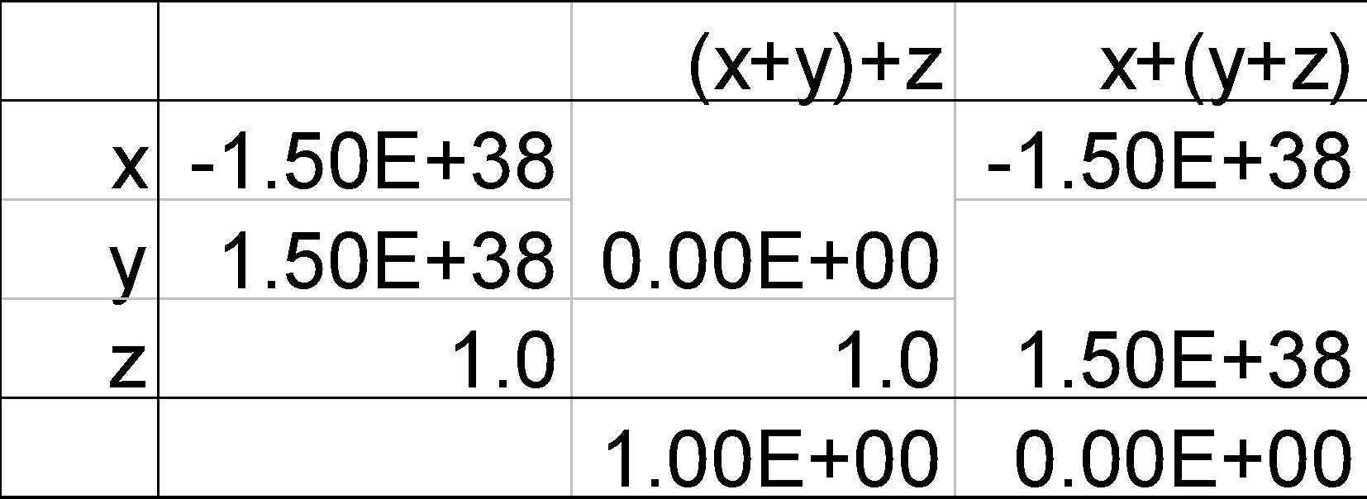
Associativity
Parallel programs may interleave operations in unexpected orders
Assumptions of associativity may fail
Need to validate parallel programs under varying degrees of parallelism
Chapter 3 — Arithmetic for Computers — ‹#›
Notes:
Morgan Kaufmann Publishers
*
Chapter 3 — Arithmetic for Computers
‹#›

Slide 50
Who Cares About FP Accuracy?
Important for scientific code
But for everyday consumer use?
“My bank balance is out by 0.0002¢!” ☹
The Intel Pentium FDIV bug
The market expects accuracy
See Colwell, The Pentium Chronicles
Chapter 3 — Arithmetic for Computers — ‹#›
Notes:
Morgan Kaufmann Publishers
*
Chapter 3 — Arithmetic for Computers
‹#›

Slide 51
Concluding Remarks
Bits have no inherent meaning
Interpretation depends on the instructions applied
Computer representations of numbers
Finite range and precision
Need to account for this in programs
§3.10 Concluding Remarks
Chapter 3 — Arithmetic for Computers — ‹#›
Notes:
Morgan Kaufmann Publishers
*
Chapter 3 — Arithmetic for Computers
‹#›

Slide 52
Concluding Remarks
ISAs support arithmetic
Signed and unsigned integers
Floating-point approximation to reals
Bounded range and precision
Operations can overflow and underflow
Chapter 3 — Arithmetic for Computers — ‹#›
Notes:
Morgan Kaufmann Publishers
*
Chapter 3 — Arithmetic for Computers
‹#›

